Slide 1


micro:bit robot entry tutorial
Lesson 5
micro:bit advanced lesson 5 “Full light control”
YahBoom micro:bit video tutorial

Slide 2
micro:bit robot entry tutorial
Content
Part1
Part 2
Part3
Part 4
Learning goals
Preparation
Search for blocks
Combine blocks
YahBoom micro:bit video tutorial

Slide 3
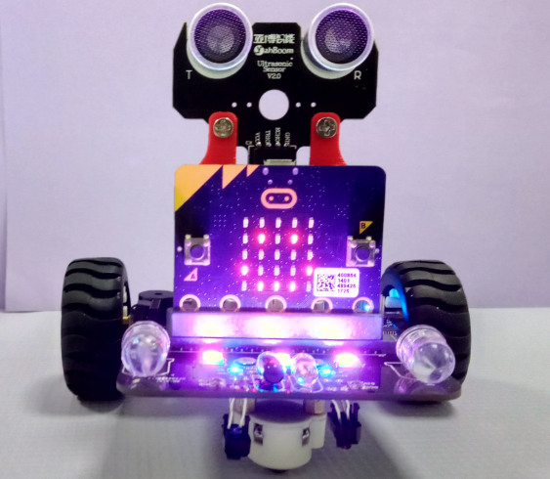
micro:bit robot entry tutorial
Part 1
Learning goals
After you have downloaded the program, you can see a smile on the car's dot matrix, and all the seven color flow lights are lit up. Now, the light is lit up with purple, and the children can choose to light the other colors in the program.
YahBoom micro:bit video tutorial

Slide 4
micro:bit robot entry tutorial
Part 2
Hardware:
● 1 X USB cable
● 1 X micro:bit robot
Preparation
Then the micro:bit is connected to the computer through USB, and the computer will pop up a U disk and click the URL in the U disk to enter the programming interface. Input this URL https://github.com/lzty634158/yahboom_mbit_en to get the package.
YahBoom micro:bit video tutorial

Slide 5
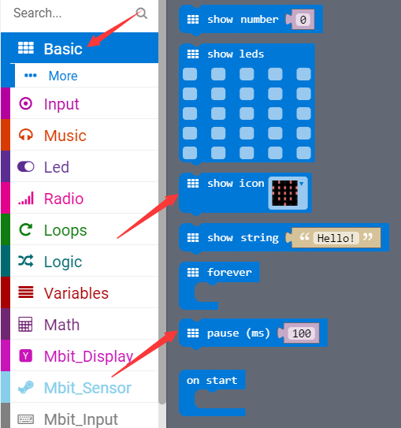
micro:bit robot entry tutorial
Part 3
Search for blocks
YahBoom micro:bit video tutorial

Slide 6
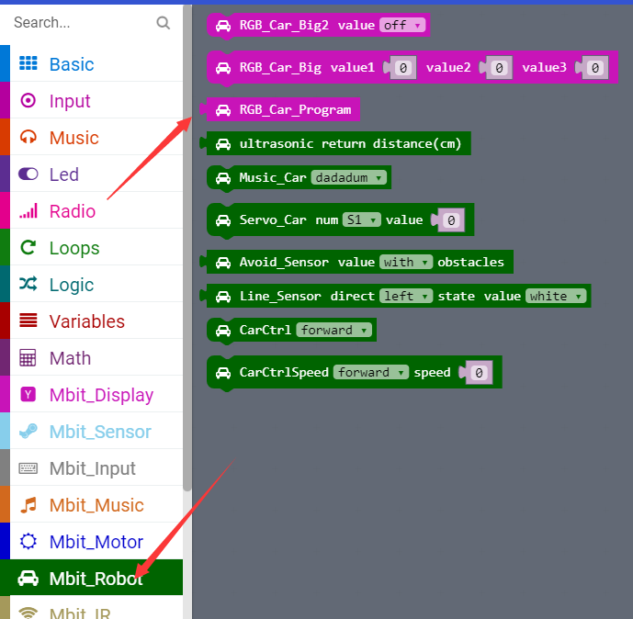
micro:bit robot entry tutorial
Part 3
Search for blocks
YahBoom micro:bit video tutorial

Slide 7
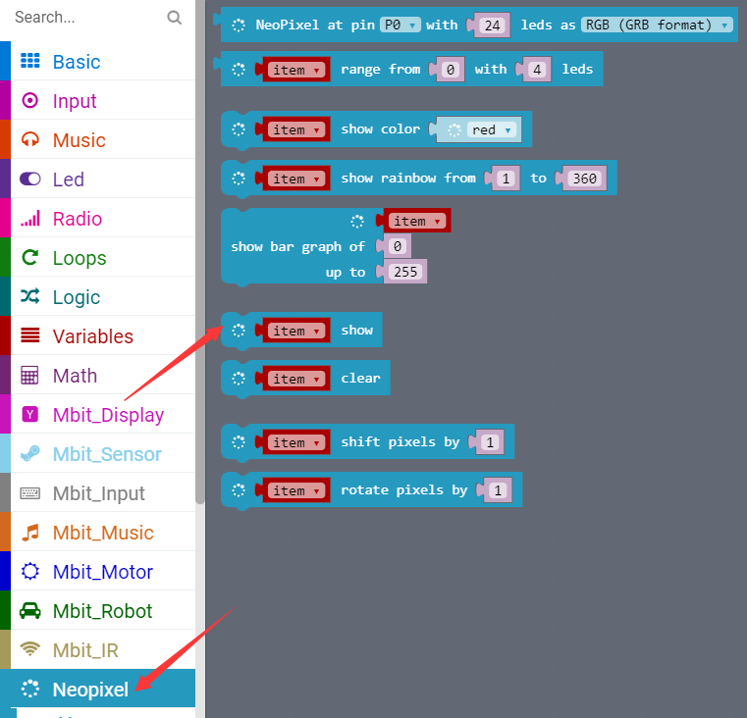
micro:bit robot entry tutorial
Part 3
Search for blocks
YahBoom micro:bit video tutorial

Slide 8
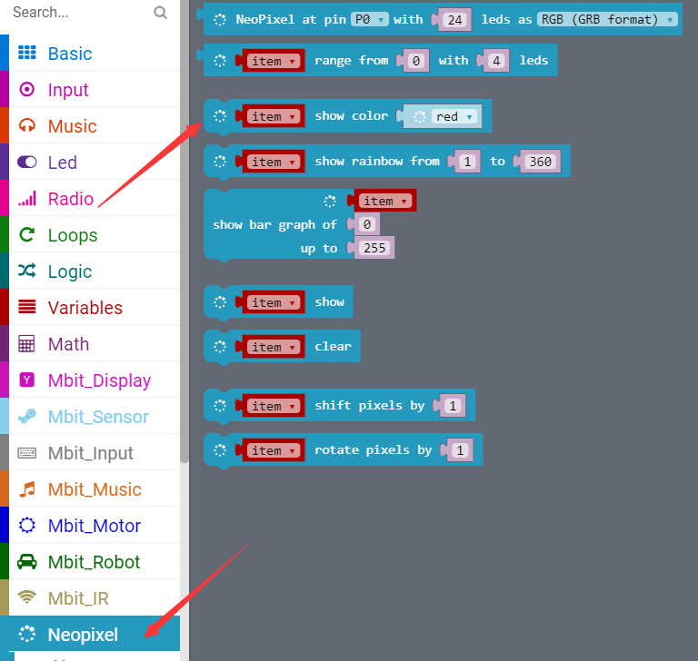
micro:bit robot entry tutorial
Part 3
Search for blocks
YahBoom micro:bit video tutorial

Slide 9
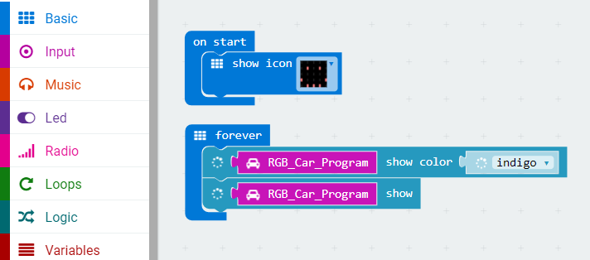
micro:bit robot entry tutorial
Part 4
Combine blocks
The courses about water lamp need to turn off the power before downloading the new program, otherwise the water lantern will always be on.
YahBoom micro:bit video tutorial

Slide 10
micro:bit robot entry tutorial
robot
lesson
Thanks for watching！
Powered by YahBoom
YahBoom micro:bit video tutorial

